Slide 1



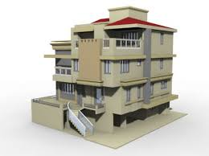




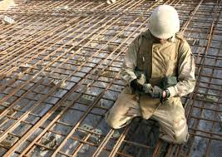

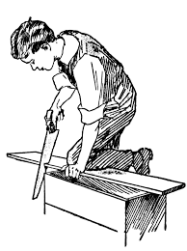
Paper Presentation Titled : Influence of Construction Crafts’ Skills Acquisition and Critical Knowledge Development on Project Performance in Nigeria
oyo
TO
BY
Anthony Okwogume Ujene (PhD) &
Akaninyene Afangide Umoh (PhD)

Slide 2


Preamble
Artisans are needed in large quantity, they
contribute skillfully with their hands based on
dexterity, practical & theoretical knowledge and social ability for
The responsibility imposed by National Building code
The need for better practices, better performance, waste minimization, and
sustainable development calls for enhanced skill development
Project
Practical
Realization
2
2

Slide 3

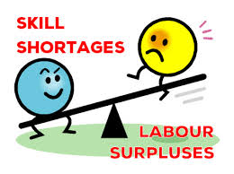


What are the Problems?
OLUYOLE
2015
Poor performance of the construction
industry, partly attributable to
Insufficient skill quantity(skill shortage))
Inadequate skill quality (Skill Gap)
Result in poor quality, cost overrun, delay,
Abandonment, client dissatisfaction,
Disputes, Loss of confidence, Frustration
3
3

Slide 4



Aim & objectives
OLUYOLE
2015
Aiming at 3 -Objectives
Providing an insight into
by evaluating
Usage of skill acquisition practices among
construction artisans, (obj-1)
influence of skill acquisition practices on
productive knowledge (obj-2)
productive knowledge influence on performance(obj-3)
Skill acquisition
Practices
Productive
Knowledge
Project
Performance
4
4
Notes:
Objectives 1, 2, & 3 gave rise to 3 hypothses

Slide 5
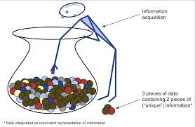

Method used
OLUYOLE
2015
Exploratory survey design -structured questionnaires
Population- Masons (87), Carpenters (79), Iron-bender (73), Painters (58), Plumbers (66), and Electricians (60), total=423 artisans from four zones.
Twenty one skill acquisition practices,
Twenty types of productive knowledge
Five project performance indicators
Tools- Severity index, Kruskal-wallis &
Spearman correlation tests.
5
5

Slide 6
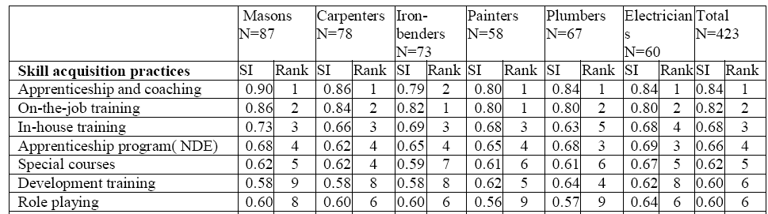
Results
OLUYOLE
2015
Extent of use of Skill acquisition practices
Kruskal-wallis test gave 0.956 > 0.05 significance level
show similarity in view that may be attributable to :
the low level of education of majority of them,
general lack of situational awareness among artisans
general concentration on certain practices for skill acquisition.
6
6

Slide 7
Results
OLUYOLE
2015
Influence of skill acquisition practices on productive knowledge
 | Productive Knowledge |  |  |  |  | Estimation % Influence
Skill acquisition practices | 1 | 2 | 3 | 4 | 5
Apprenticeship and coaching | x | x |  | x | x | 20
On-the-job training | x | x | x |  |  | 40
In-house training | x | x | x |  | x | 20
Apprenticeship program( NDE) |  | x | x |  |  | 60
Special courses | x | x |  | x | x | 20
Development training | x | x |  | x | x | 20
Role playing |  |  |  | x |  | 80
Average influence |  |  |  |  |  | 37%
X= insignificant influence (p >0.05);  = significant influence (p <0.05)
1-Creative competence, 2- Practical competence; 3-Collaboration and team working ability 4-Negotiation competence; 5-Leadership/control competence
The level of use of majority of the skill acquisition methods do not result in adequate attainment of the required productive knowledge of the artisans.
attributable to poor skill transfer and lack of interest due to emphasis on academic qualification.

Slide 8
Influence of productive knowledge on project performance
Results
OLUYOLE
2015
 | Project performance Indicators |  |  |  |  | Estimation % Influence
Critical Productive Knowledge | 1 | 2 | 3 | 4 | 5
Practical competence | x | x | x | x | x | 0
Collaboration and team working ability |  |  |  | x | x | 60
Negotiation competence | x | x | x | x | x | 0
Leadership/control competence | x | x | x |  | x | 20
Creative competence | x |  | x |  | x | 40
Average influence |  |  |  |  |  | 24%
X= insignificant influence (p>0.05);  = significant influence (p<0.05)
1-Quality; 2- Productivity; 3-Client satisfaction; 4-Time; 5-Cost
current level of critical knowledge attained by the artisans have very low influence on project performance – 24%
Which may be attributable to the skill gap and shortage globally observed .
8
8

Slide 9
Conclusions
OLUYOLE
2015
33% of identified skill acquisition practices have significant level of use
apprenticeship and coaching, On-the-job training, in-house training, apprenticeship program(NDE), development training and role playing- mostly used
There is agreement on perceptions of the artisans
Current skill acquisition methods do not result in adequate attainment of productive knowledge of the artisans
current level of critical knowledge attained by the artisans have very low influence on project performance

Slide 10
Recommendations
OLUYOLE
2015
stakeholders should evolve skill acquisition policies which involve public- private partnership and promote productive knowledge and high levels of competences.
Government should develop national schemes for recognition of skills through the assessment and certification of skills with appropriate knowledge.
Government should encourage young women to enter apprenticeships to check occupational segregation and provide equitable and high-quality training for both young men and women.

Slide 11



OLUYOLE
2015
THANK YOU
FOR BEING A
WONDERFUL AUDIENCE
I Love You All
I look forward to Your Questions and
Comments
11
11

